Slide 1

DR. FAHEEM AKHTAR
Ph.D. (Zhejiang University)
Assistant Professor

Slide 2
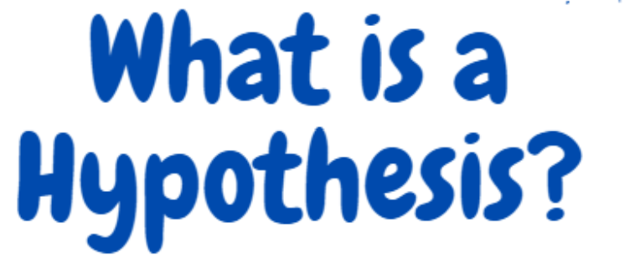
Hypothesis:
"Employee participation in decision-making is positively related to job satisfaction among middle managers."
Variables:
  Independent Variable: Employee participation in decision-making
  Dependent Variable: Job satisfaction
Relationship Stated: Positive relationship (as participation increases, job satisfaction is expected to increase)
Formal & Tentative: It is a testable prediction, not a conclusion — the study will confirm or reject it with data.
Hypothesis is a formal tentative statement of the expected relationship between two or more variables under the study.
Example:
Research Problem:
Employee turnover is high in the marketing department.
Research Objective:
To determine whether increasing salaries reduces employee turnover.
Hypothesis (Prediction):
"Increasing salaries by 10% will reduce employee turnover rates in the marketing department within six months.“
This shows how the research problem and objective are translated into a clear prediction that can be tested, turning a general issue (“high turnover”) into a measurable outcome (“turnover will decrease after a salary increase”).
Its helps to translate the research problem and objectives into a prediction of the expected results or outcomes of the research study.

Slide 3
A clearly stated hypothesis includes the variables to be manipulated or measured, identifies the population to be examined and indicates the proposed outcome for the study.
Example
Hypothesis:
"Implementing a flexible work schedule will increase job satisfaction among employees in the sales department."
Variables:
  Independent variable (manipulated): Flexible work schedule (e.g., allowing employees to choose start/end times)
  Dependent variable (measured): Job satisfaction (measured through an employee satisfaction survey)
Population:
Employees in the sales department of the organization
Proposed Outcome:
Job satisfaction scores will increase after the implementation of flexible schedules compared to before.
A well-stated hypothesis should have three main elements:
Variables – It must specify what you will manipulate (independent variable) and what you will measure (dependent variable).
Population – It must identify the group or sample on which the study is conducted.
Proposed Outcome – It should clearly predict the expected result or relationship between the variables.

Slide 4
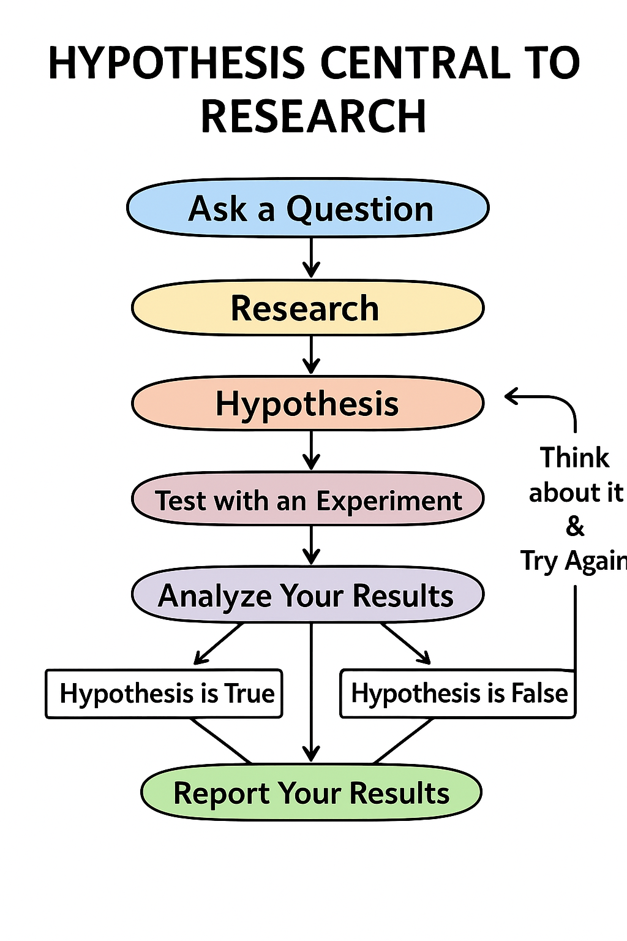

Slide 5
Definition
“Hypothesis is a tentative prediction or explanation of the relationship between two variables’ It implies that there is a systematic relationship between an independent and dependent variable”.
“Hypothesis is a shrewd guess or inference that is formulated and provisionally adopted to explain observed facts or conditions and to guide in further investigations”
… GOOD & HATT

Slide 6
Importance of Hypothesis
Hypothesis:
"Introducing a peer-mentorship program will improve employee engagement and reduce turnover rates in a technology company."
Variables:
  Independent variable: Peer-mentorship program (new initiative introduced)
  Dependent variables: Employee engagement (measured via surveys) and turnover rate (HR data)
Population:
Employees of a technology company
Proposed Outcome:
Engagement levels will rise, and turnover rates will fall after the program is implemented.
How It Helps in Theory Building
If repeated studies across different organizations show similar results, researchers can develop a theory that peer mentoring strengthens employee engagement and retention, contributing to organizational success.
This can eventually form part of a broader theoretical framework explaining how social support mechanisms improve organizational outcomes.
Hypothesis enables the researcher to objectively investigate new areas of discovery, thus helps in theory building.
Hypothesis:
"Adopting a transformational leadership style will increase employees’ innovative behavior in a manufacturing company."
How It Provides Objectivity:
  The researcher isn’t just “assuming” leadership improves innovation — the hypothesis sets a specific, testable claim.
  Data is then collected (e.g., leadership style measured via Multifactor Leadership Questionnaire, innovation measured by number of new process ideas submitted).
  Statistical analysis (e.g., regression) is used to confirm or reject the hypothesis based on evidence, rather than opinion or bias.
Hypothesis provides objectivity to the research activity.
Hypothesis:
"Introducing flexible working hours will increase employee productivity in the finance department."
How It Gives Direction:
  Focus of Study: Researcher knows to focus on flexible hours as the independent variable and productivity as the dependent variable.
  Data Collection: Guides them to collect data on working hours, output per employee, and performance scores.
  Method Selection: Encourages using a before-and-after comparison or statistical tests to see if productivity changes after the policy.
  Outcome: Research stays targeted on testing the effect of flexible work hours, avoiding irrelevant data collection.
Hypothesis provides directions to conduct research.

Slide 7
Importance of Hypothesis
Hypothesis provides clear and specific goals to the researchers. These goals provide the investigator with a basis for selecting sample and research procedures to meet the set goals.
Hypothesis:
"Providing customer service training will improve customer satisfaction scores by at least 15% in the call center."
Clear & Specific Goal:
The researcher’s goal is to determine whether training leads to a measurable improvement in satisfaction scores.
Basis for Selecting Sample:
The researcher selects call center employees as the sample group because they are the ones receiving training.
Basis for Research Procedures:
  Measure customer satisfaction scores before and after training.
  Use statistical tests (e.g., paired t-test) to compare the results.
Example
Theory (Customer Satisfaction Theory):
Higher customer satisfaction leads to stronger customer loyalty.
Hypothesis (Linking Theory to Practice):
"Improving response time to customer complaints will increase customer loyalty among online retail shoppers."
Practical Research:
Variables measured: Response time (independent variable), Customer loyalty (dependent variable, measured through repeat purchase rate).
Population: Customers of an online retail platform.
Expected Outcome: Faster complaint handling results in higher customer loyalty.
Hypothesis provides a link between theories and actual practical research.

Slide 8
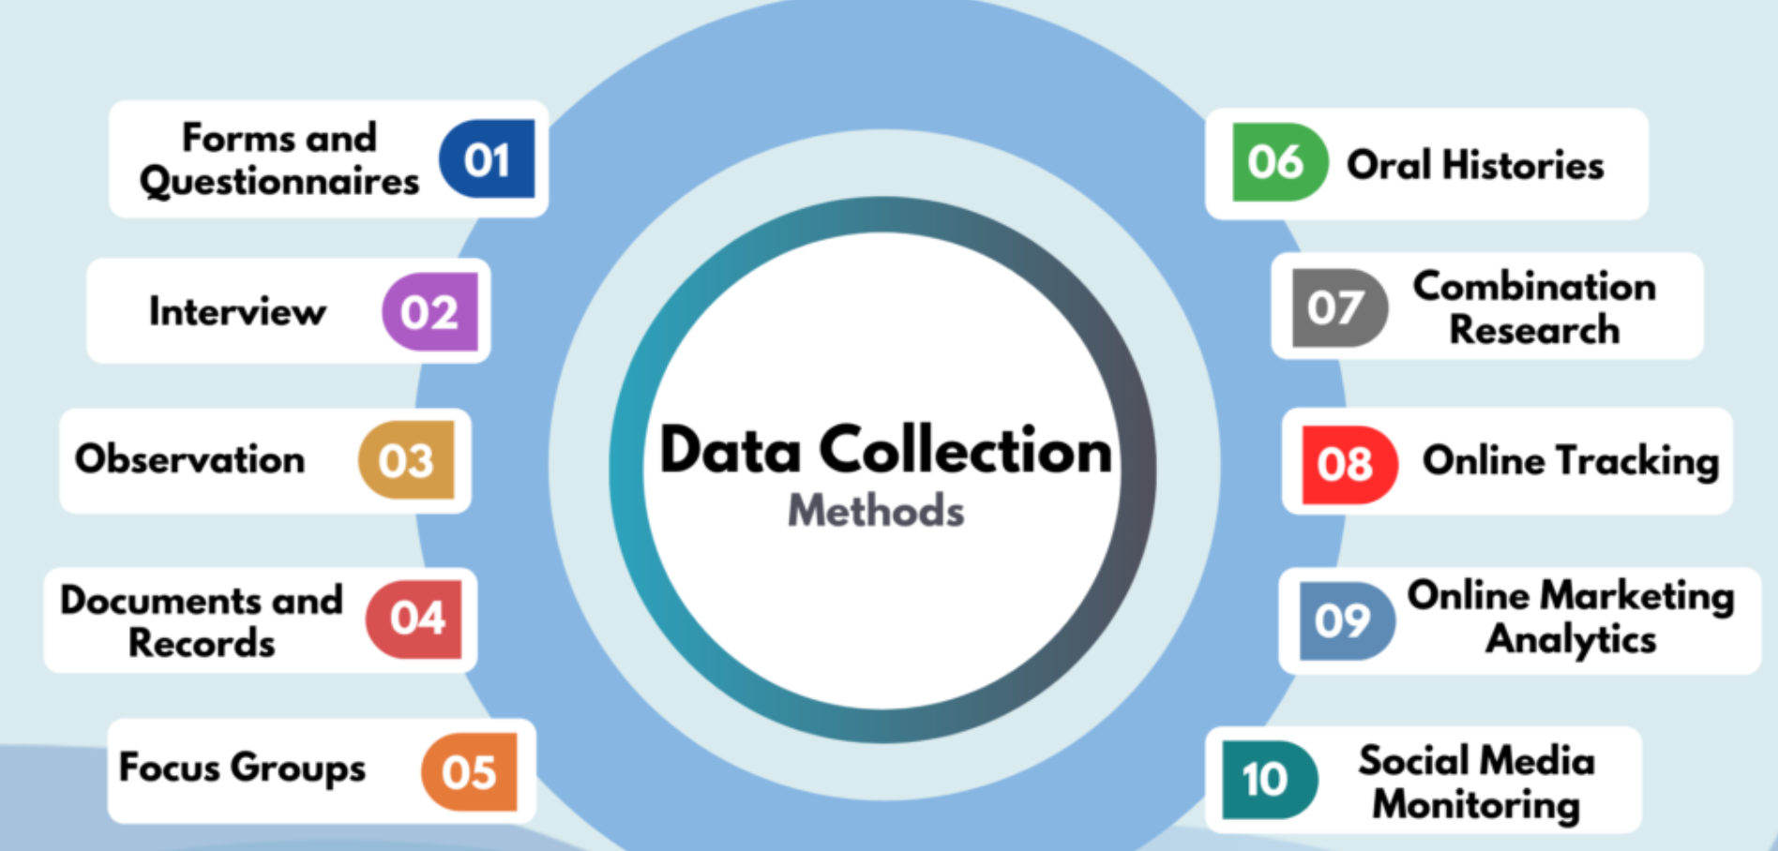
Data Collection

Slide 9
What is Data Collection?
Determining how data will be collected, whether through surveys, experiments, observations, interviews, archival research, or a combination of these methods.
Data collection is the systematic process of gathering information from relevant sources to answer research questions, test hypotheses, and evaluate outcomes.

Slide 10
Types of Data Collection
Primary Data Collection (first-hand data collected directly by the researcher).
Methods:
Surveys/Questionnaires
Interviews
Observations
Experiments
Focus groups

Slide 11
Types of Data Collection
Secondary Data Collection (data already collected by others)
Sources:
Government reports (e.g., census, health data)
Databases (e.g., World Bank, WHO, stock exchanges)
Academic articles and books

Slide 12
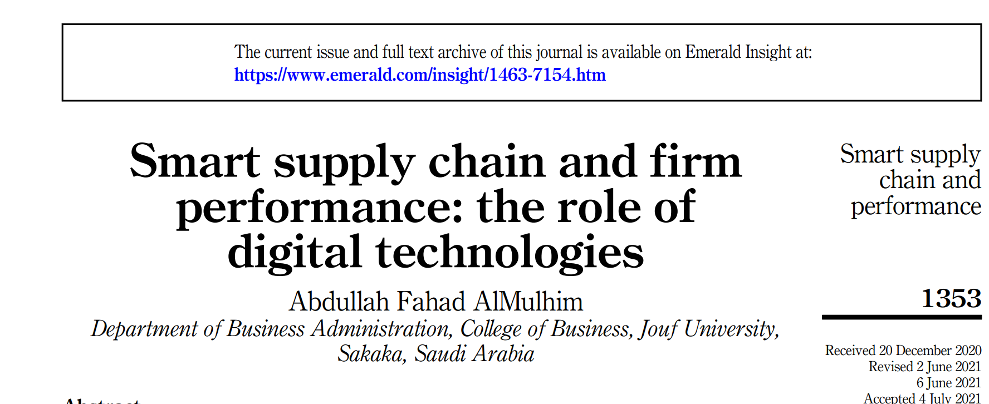
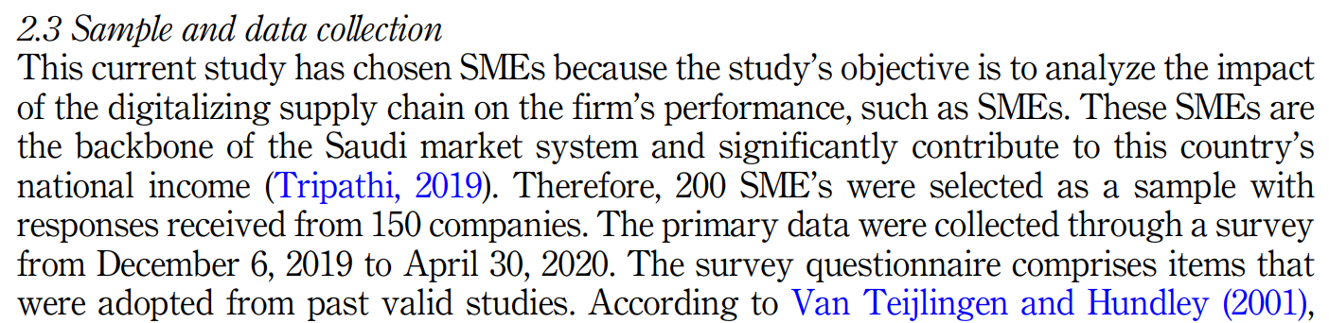
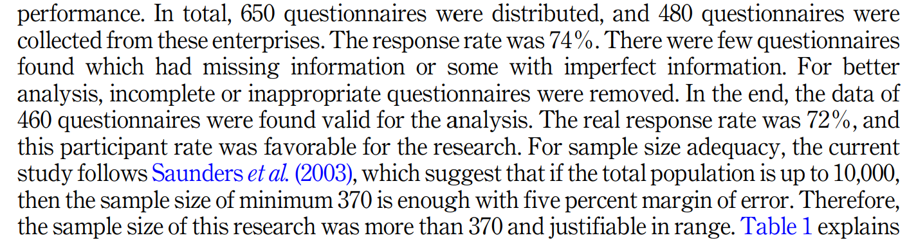



Slide 13
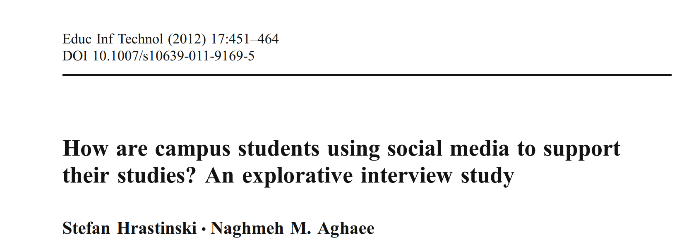
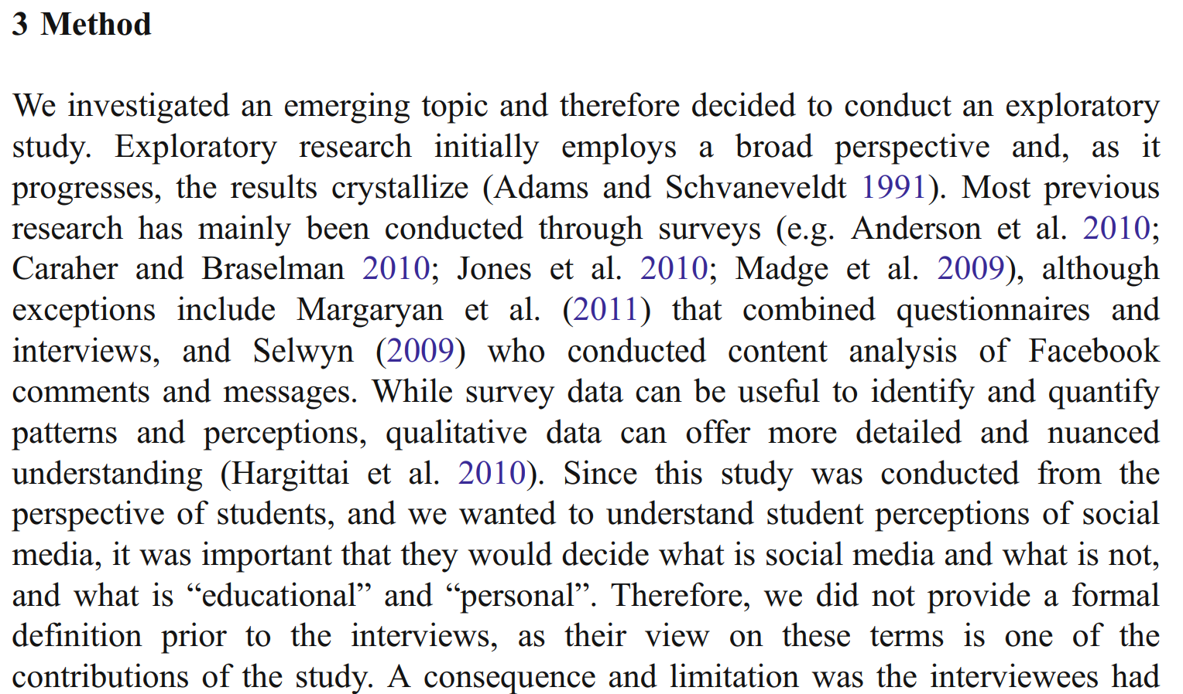
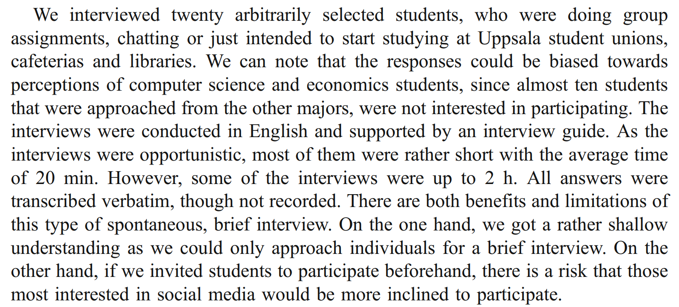


Slide 14

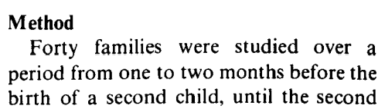
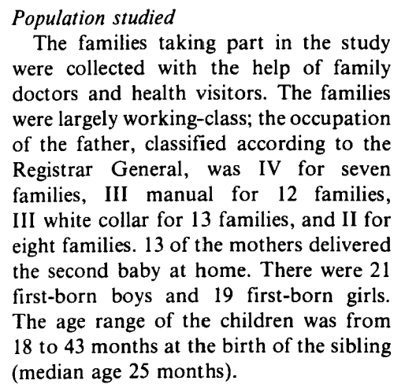
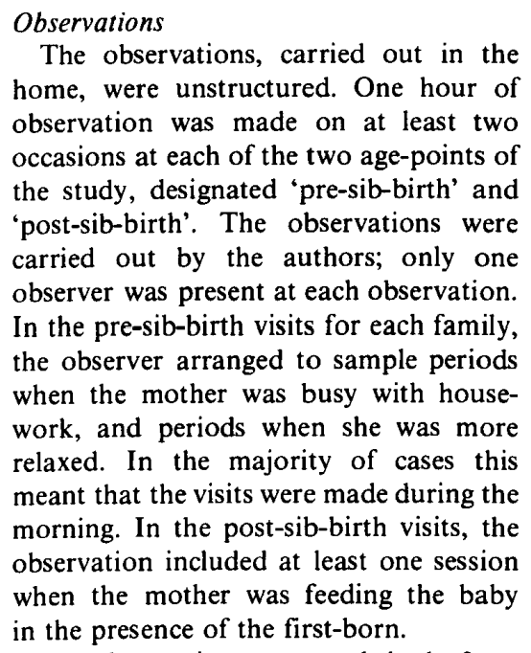
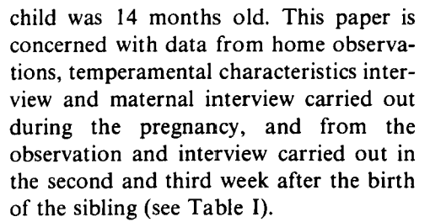

Slide 15
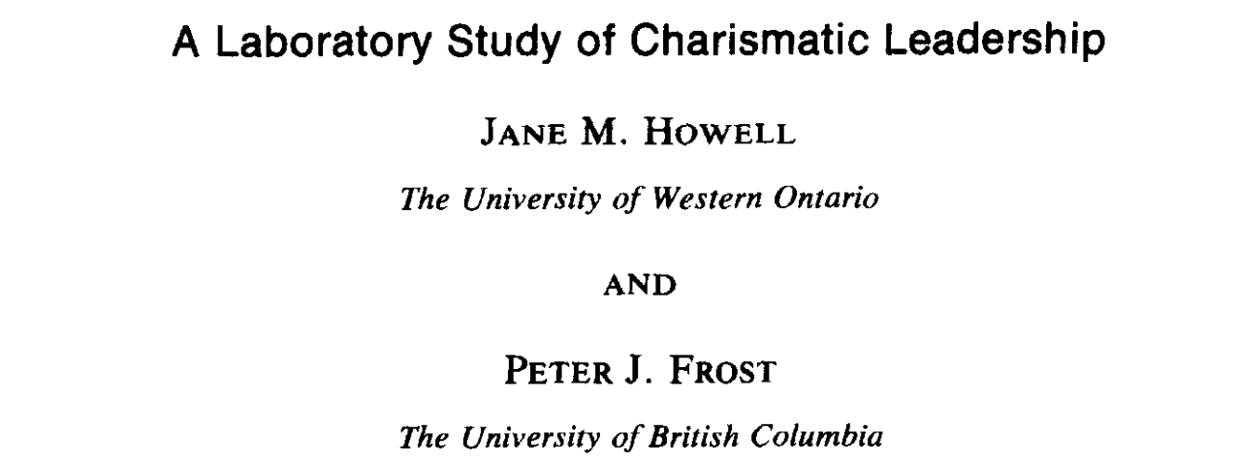
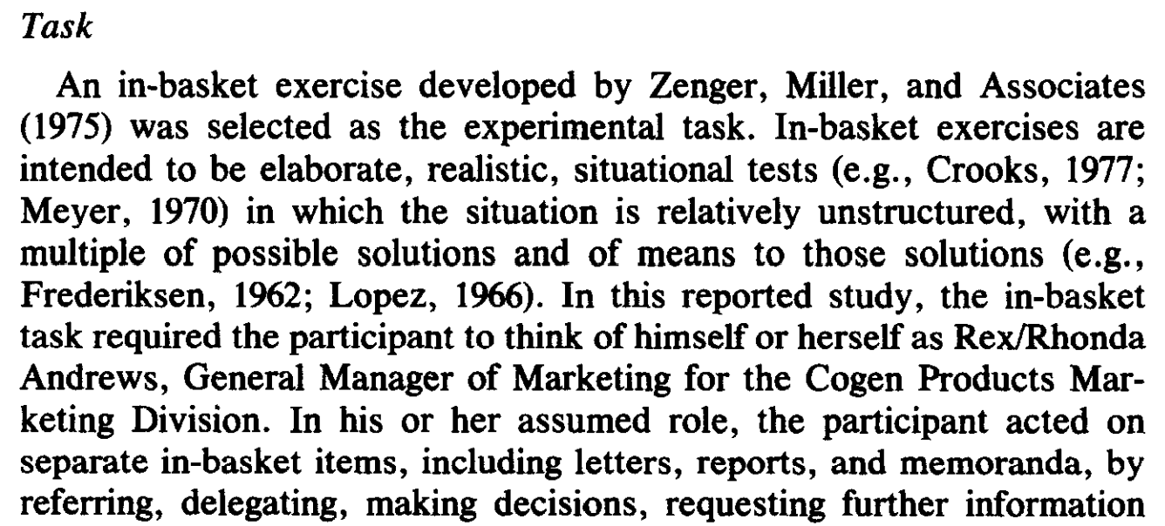
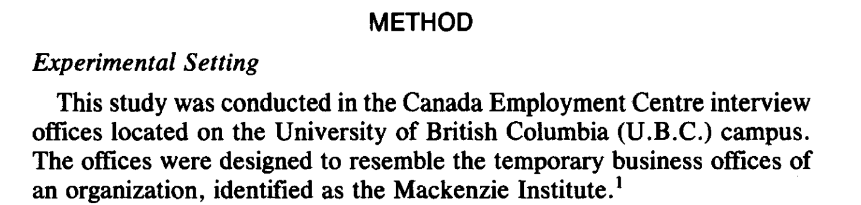
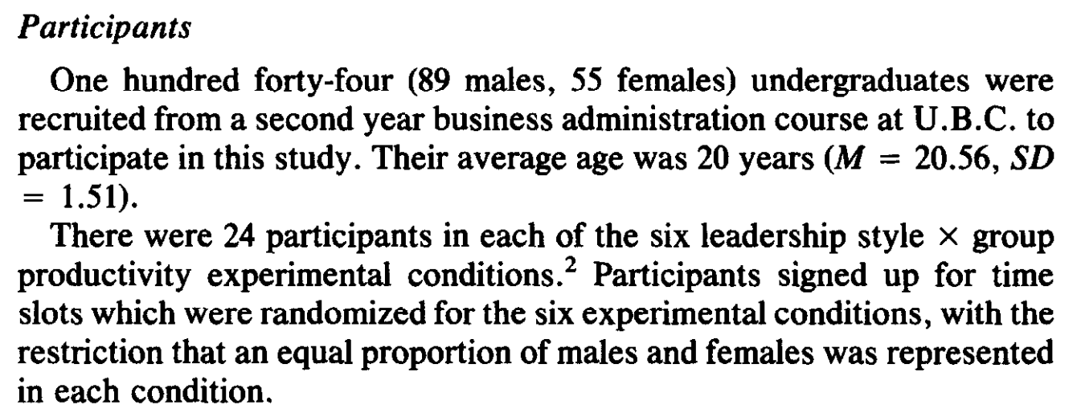
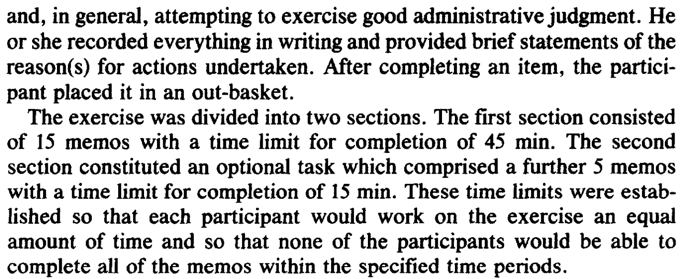

Slide 16

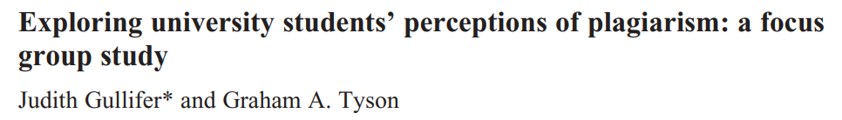
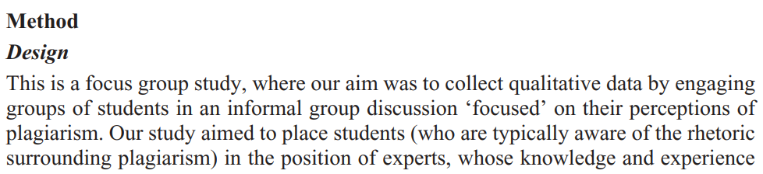
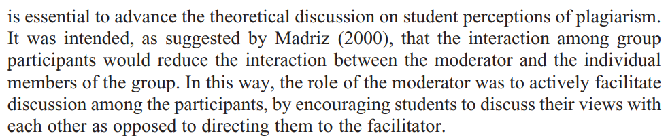
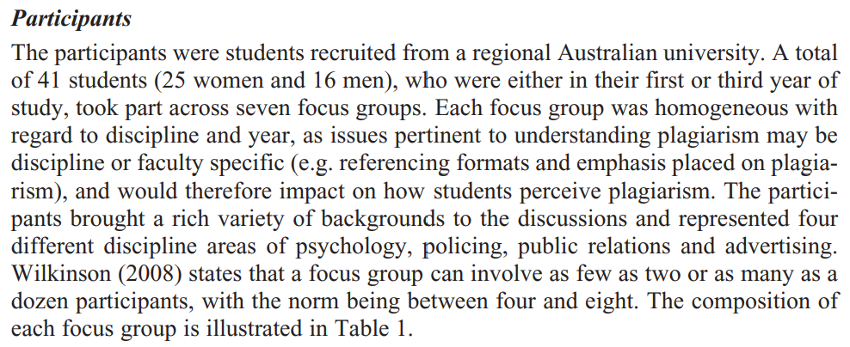

Slide 17


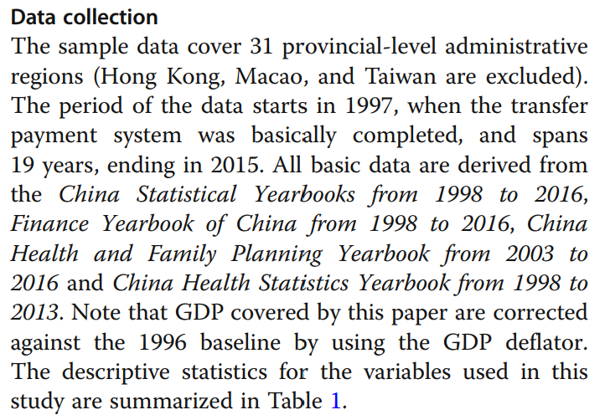
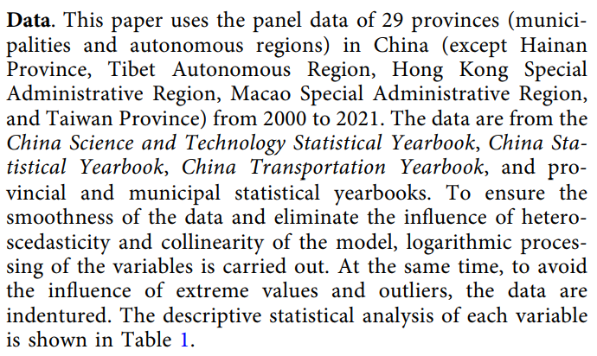

Slide 18
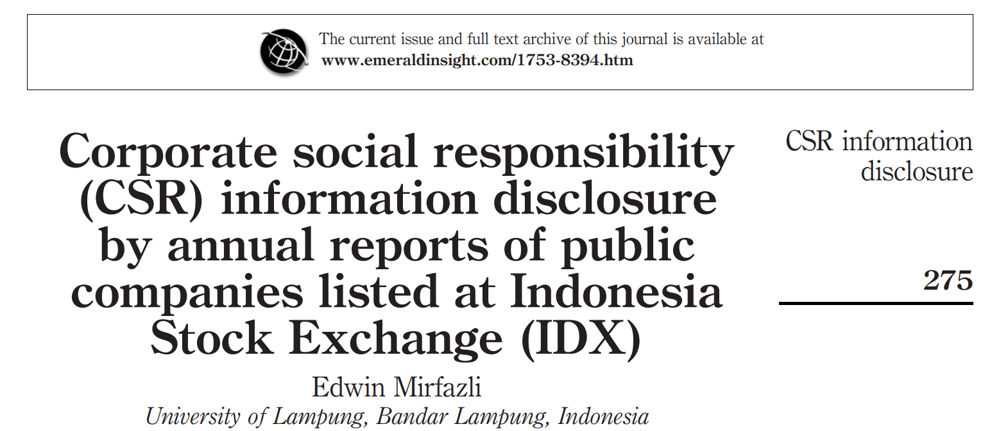

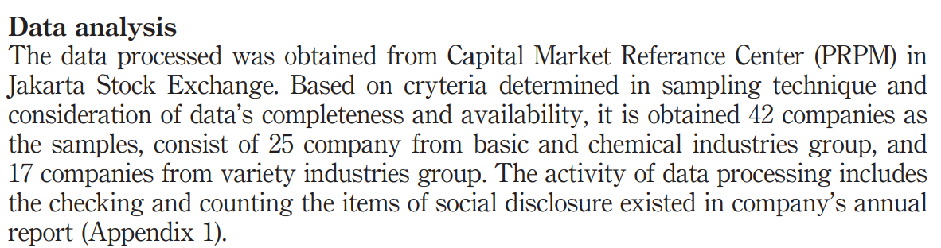
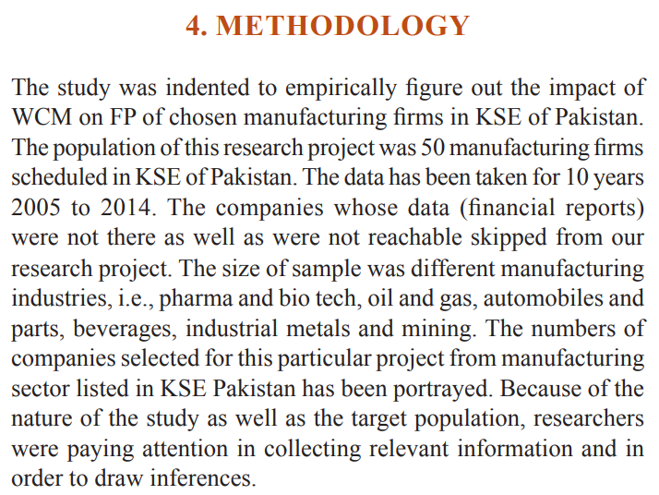
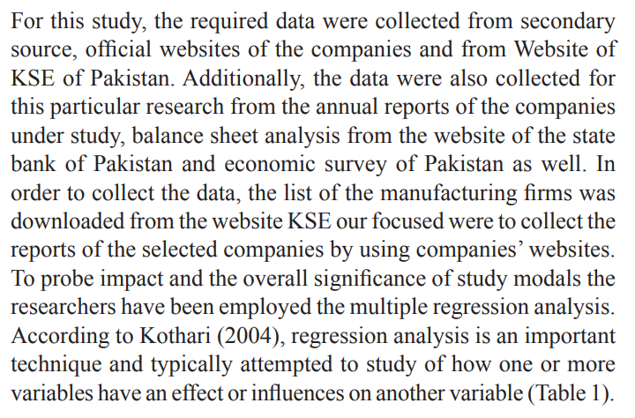

Slide 19
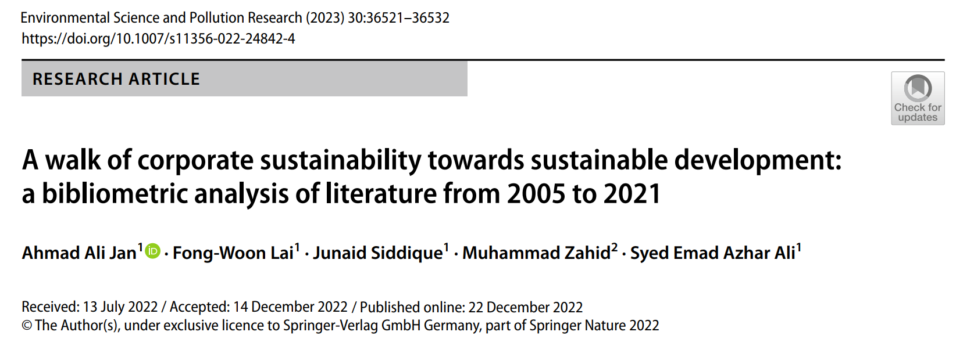

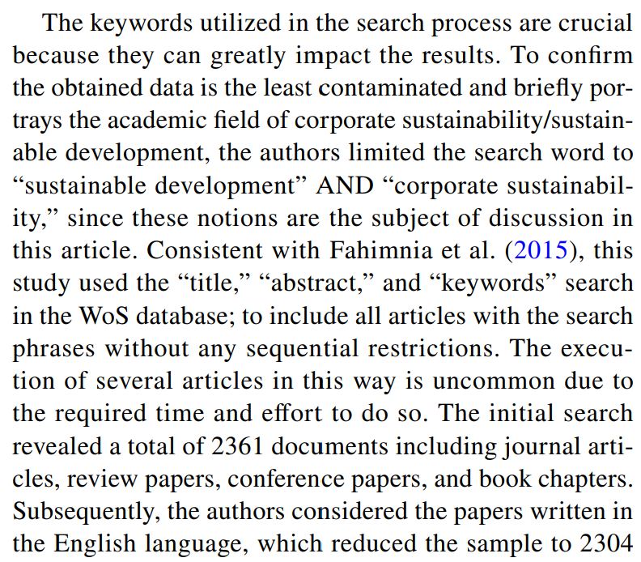
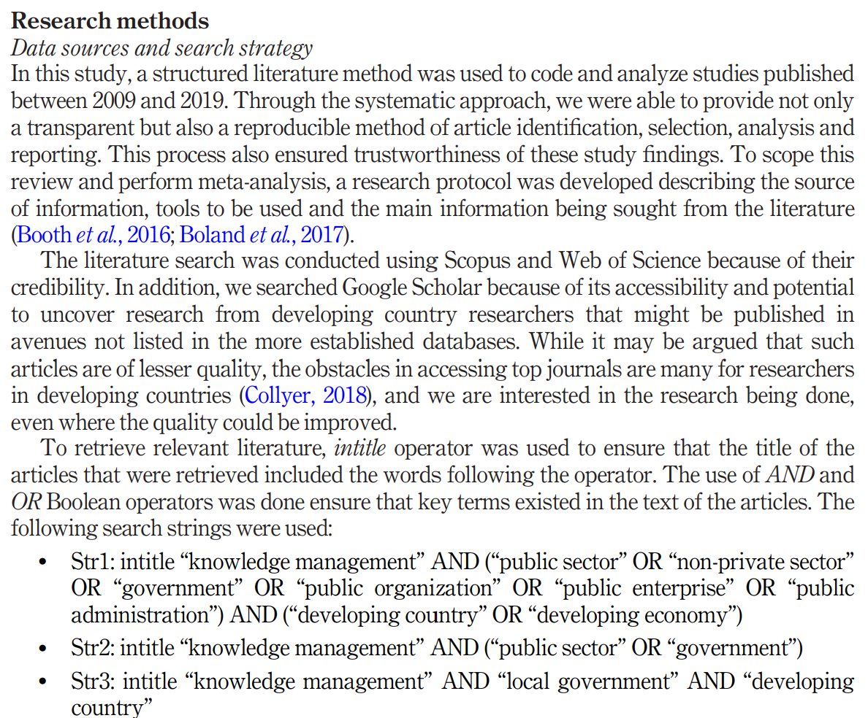
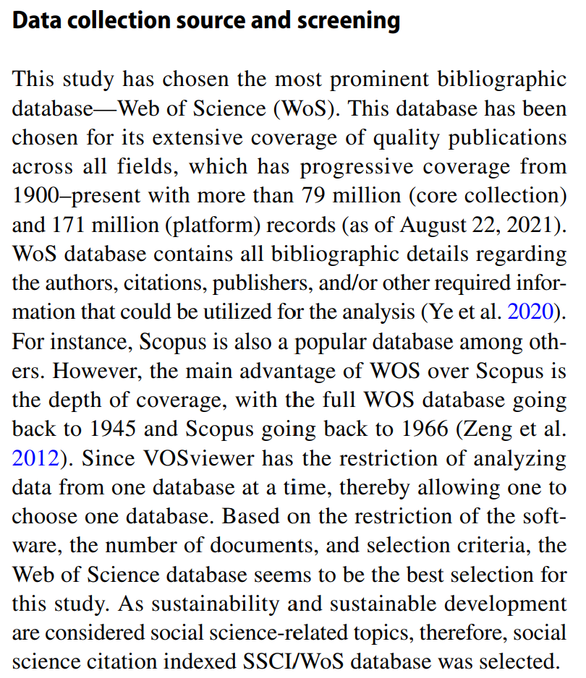
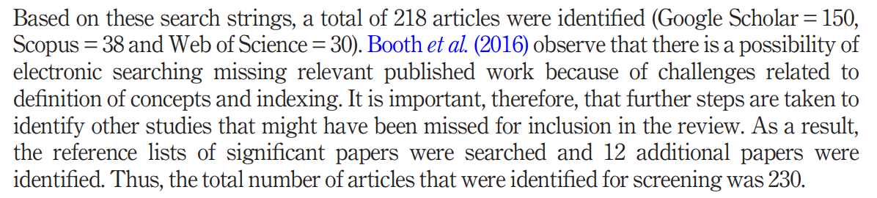


Slide 20
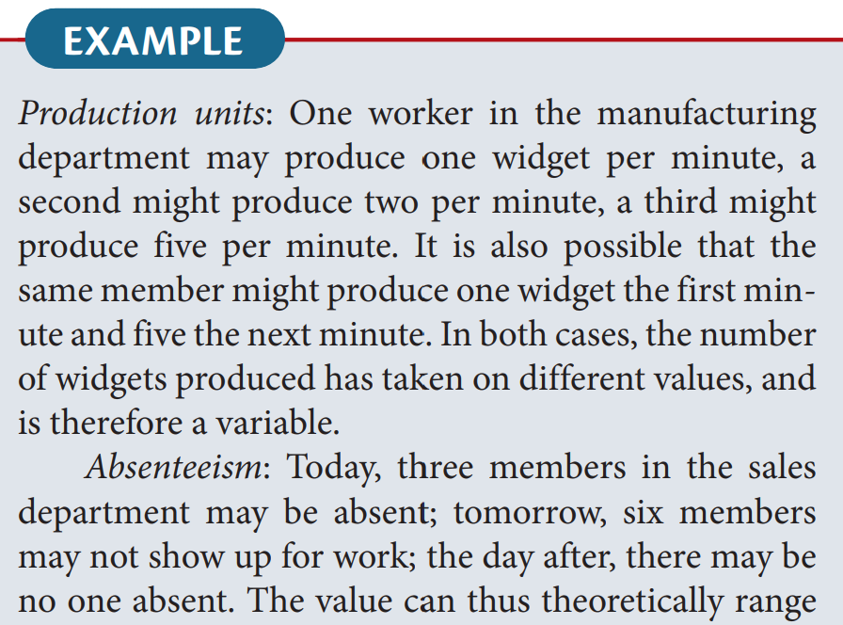
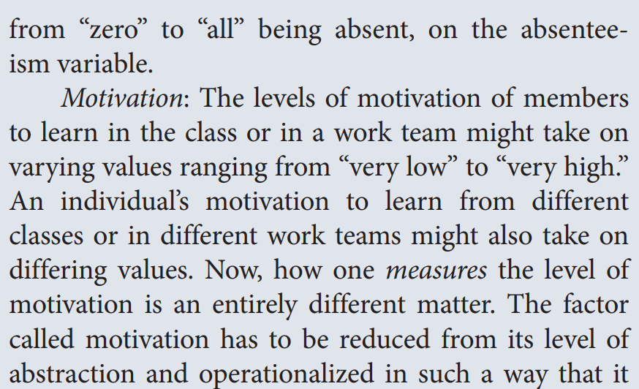

Variable - Any characteristic which is subject to change and can have more than one value such as age, intelligence, motivation, gender, etc. - Variables are “changing qualities or characteristics” of persons or things like age, gender, intelligence, ideas, achievements, confidence, and so on that are involved in your research study.
For example:
Age: (someone can be 10, 20, or 30 years old)
Gender: (male, female, other)
Motivation: (low, medium, high)
Intelligence: (different people have different levels)
In research, variables are the qualities or characteristics of people or things that we study because they don’t stay the same for everyone. They vary, that’s why we call them variables.

Slide 21
Thank you

